Slide 1
AWS Honolulu User Group
2018-02-08 – Setting Up Billing Alert

Slide 2
Setting Up a Billing Alert
Often times we are going to use the cloud to play around and test stuff such as launching an application, creating a VM, a DB, testing lambda functions, Load Balancers, etc.
Depending on the resources we created, if we forget to destroy them we may incur on extra charges.
To avoid this we can setup a Billing Alert that will send us an email when the estimated charges for the month are greater than a given threshold.

Slide 3
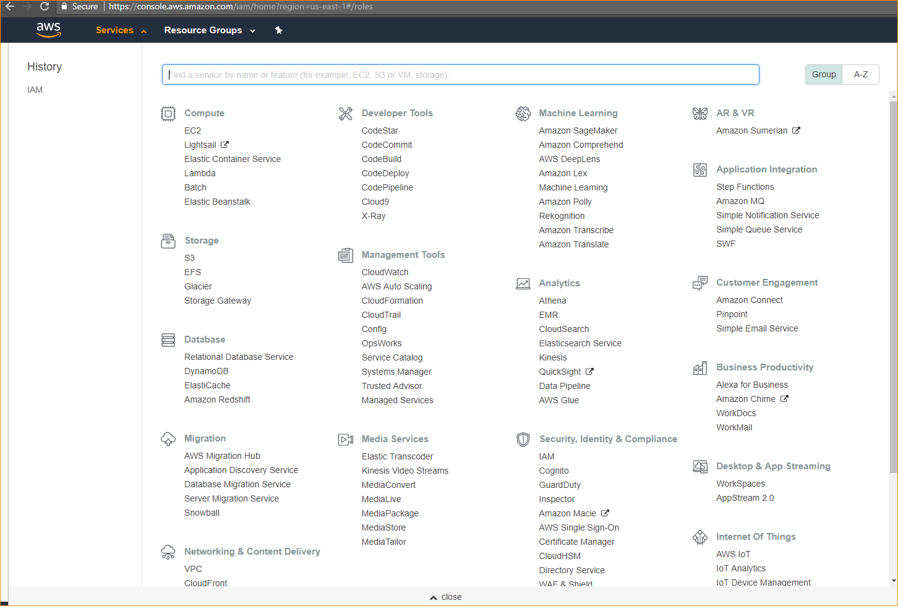
1. Go to CloudWatch service

Slide 4
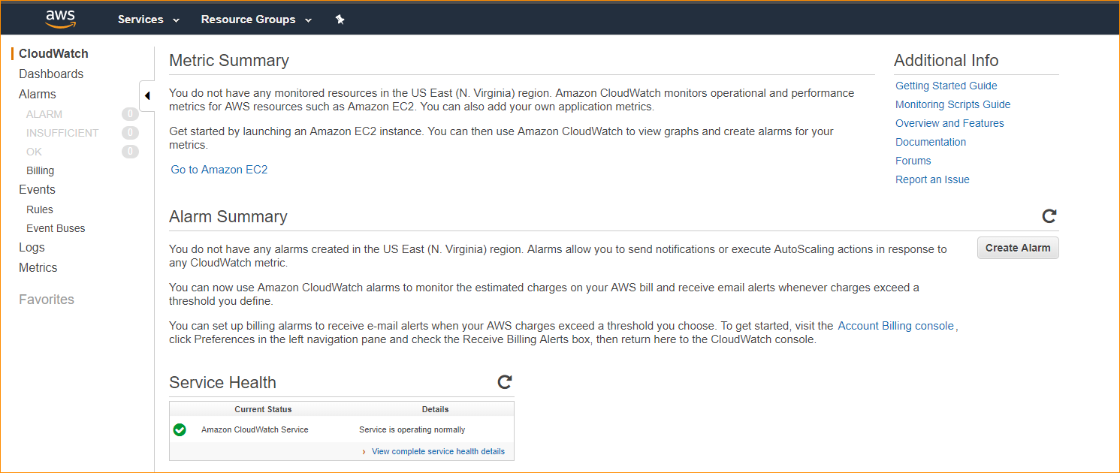
2. Go to Billing

Slide 5
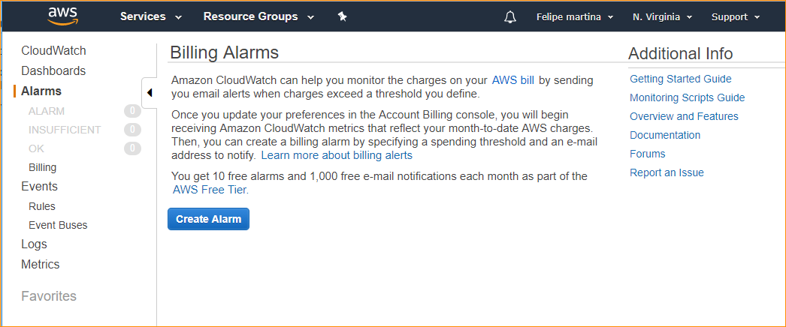
3. Click on Create Alarm
If you do not see the Create Alarm you might have to follow the steps they give you to enable Billing Metrics. It may also happen that you are not in the payer account (when using AWS Organizations)

Slide 6
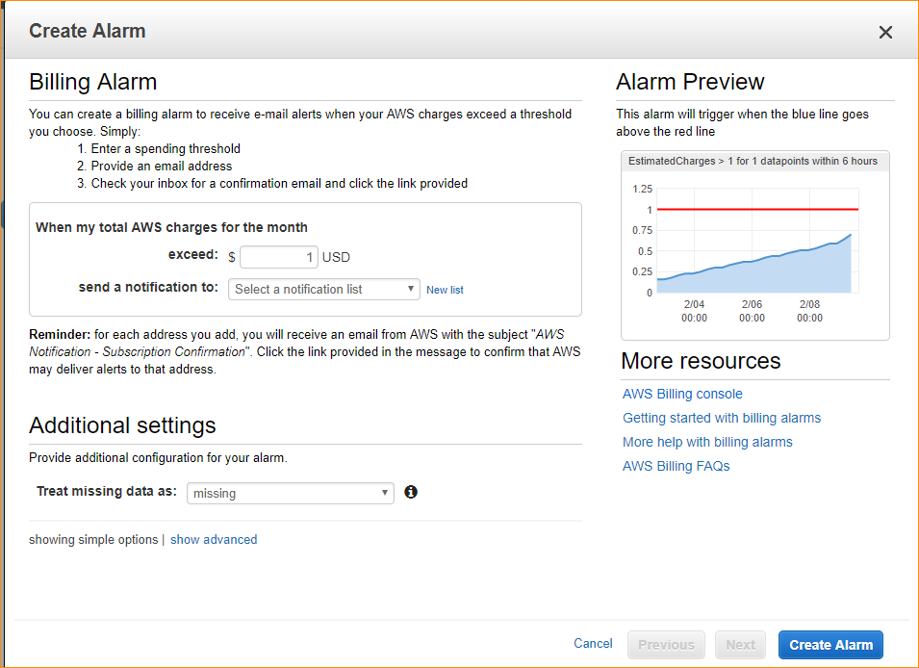
4. Select your threshold and click New List

Slide 7

5. Enter your email and Click Create Alarm

Slide 8
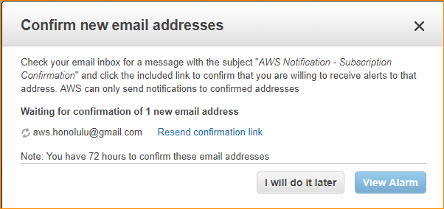
6. Check your email and confirm your email address

